Slide 1
Clinical Quality Measures
Reporting Provider Performance based on the Clinical data
- Pratik Dodia & Satish Singh

Slide 2
RoadMap
What are Clinical Quality Measures
Arenas for CQM

Slide 3
What is Clinical Quality Mesaures
Clinical quality measures, also called CQMs, are tools that help us measure and monitor the quality of healthcare and the contribution of those healthcare services towards improved health outcomes. Clinical Quality Measures & Quality Improvement

Slide 4
Arenas for CQM
Like for healthcare payments 2 different arenas for CQM have emerged: Private & Public
Private: In California, the Integrated Healthcare Association (IHA) has emerged as a forum where health plans, physician groups and hospitals come together to agree on a unified set of performance measurements, so that performance-based “report cards” are all using the same evaluation measures. The criteria set used here are HEDIS (Healthcare Effectiveness Data and Information Set) measures, which are developed and managed by the National Committee for Quality Assurance (NCQA).
NCQA develops quality measures
Public / Government:

Slide 5
CQM Terminologies
Denominator – The Population of patients or encounters for which measures applies
Numerator - The population of patients from the denominator who meet the measure specified clinical requirements or the population of encounters from the denominator where the measure specific requirement has been performed.
Exclusions & Exceptions - The population of patients from the denominator who meet the measure specified clinical requirements or the population of encounters from the denominator where the measure specific requirement has been performed. Numerator •Specifications that would remove a patient from the denominator of a specific quality measure. •Includes certain diagnoses that make it clinically unnecessary for the patient to receive the numerator clinical action and/or provider or patient determined reasons for refusing certain clinical actions.
Measurement Period - This is also known as the EHR reporting period and refers to the time frame for which the CQMs will be calculated.

Slide 6
CQM Terminologies
National Quality Strategy (NQS) domains - The six NQS domains, one of which is assigned to each CMS eCQM, are: Patient and Family Engagement, Patient Safety, Care Coordination, Population and Public Health, Efficient Use of Healthcare Resources, and Clinical Processes/Effectiveness.
National Quality Forum (NQF) - NQF reviews, endorses, and recommends use of standardized quality measures. Not all quality measures are “NQF-endorsed,” but those that are have an assigned NQF number.
Value Sets - Lists of specific values (terms and their codes) derived from single or multiple standard vocabularies used to define clinical concepts (e.g. patients with diabetes, clinical visit, reportable diseases) used in clinical quality measures and to support effective health information exchange.
Quality Reporting Document Architecture (QRDA) - An HL7-based standard document format for reporting clinical quality measure data to CMS for quality improvement programs.

Slide 7
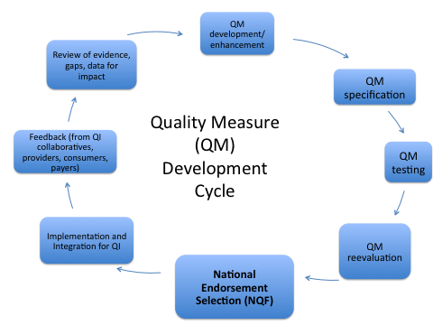
Quality Measurement Development Process
Coded Value sets that make up value sets. Groups of Value Sets make up the criteria for the denominator and numerator Coded values that make up Value Sets Value sets are used to create measure logic

